Slide 1
IMDb Data Analytics: Reinforcing SQL Skills with Real-World Queries

Slide 2
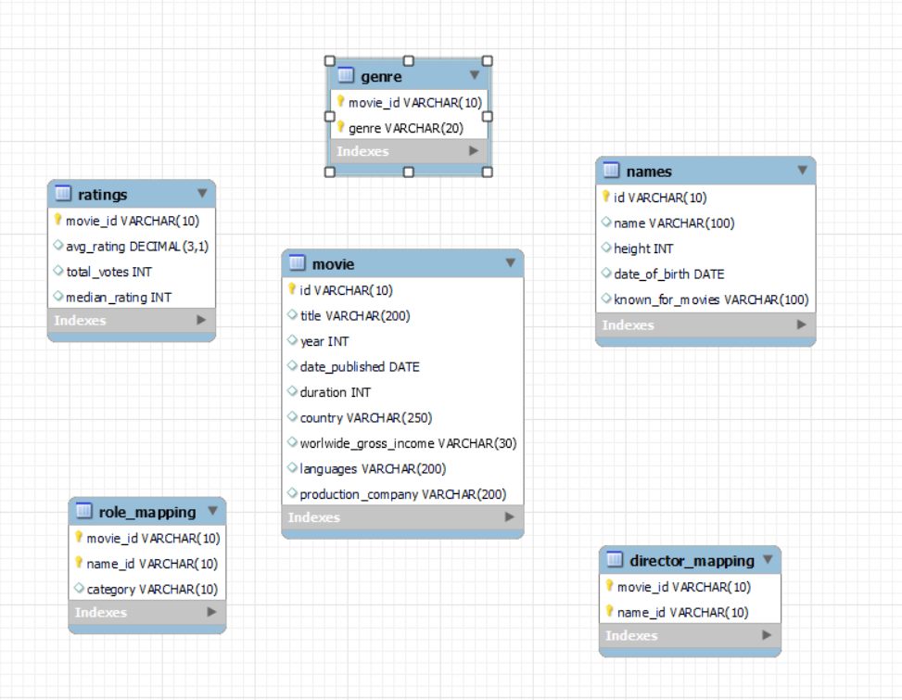
Brief intro of dataset

Slide 3
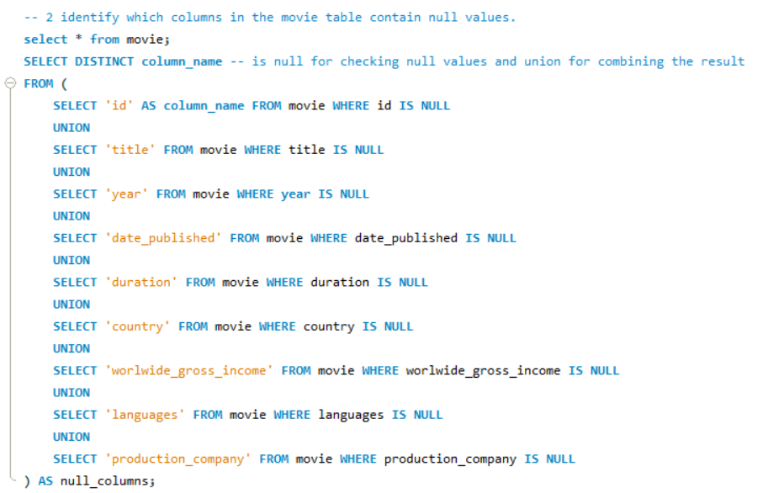
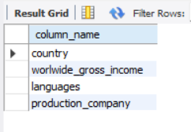
Identifying columns with null values
Output

Slide 4
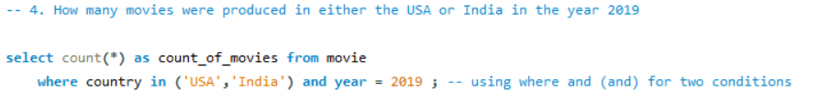
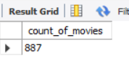
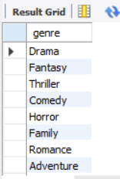
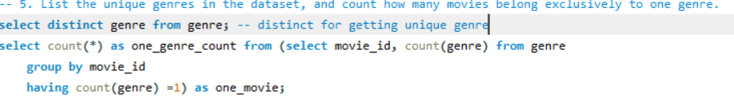

Movies in USA or India in 2019 and unique genre

Slide 5
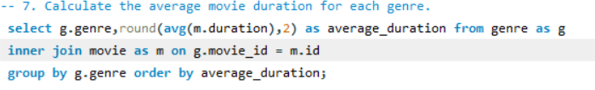
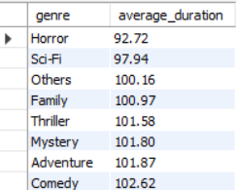
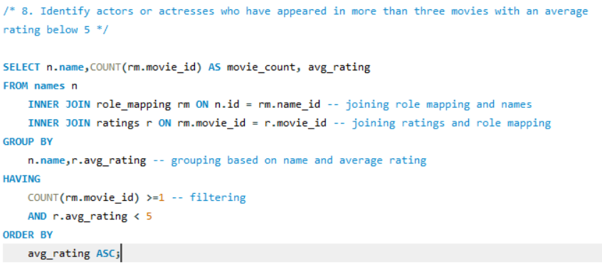
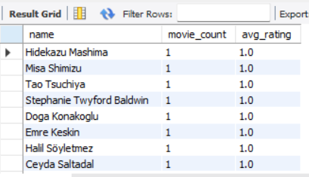
Average movie duration and actors with less rating

Slide 6
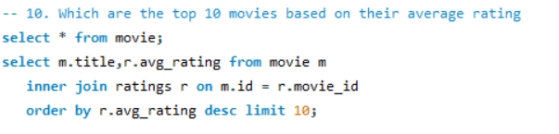
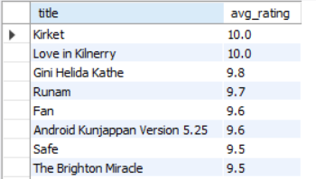
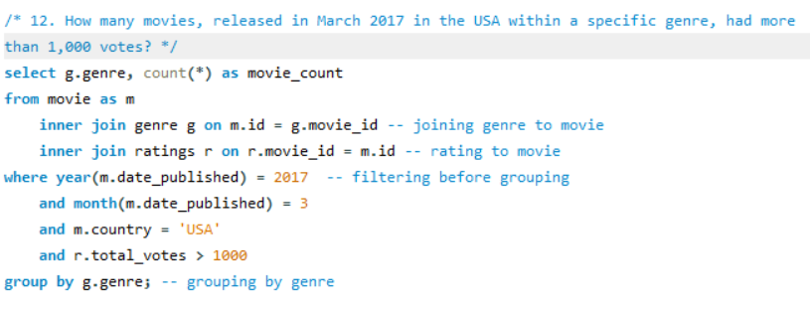
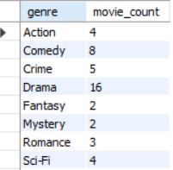
Top 10 movies and movie count for March 2017

Slide 7
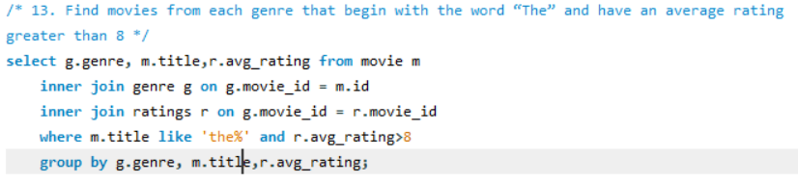
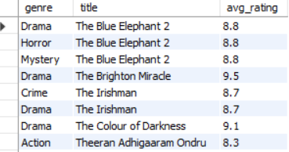
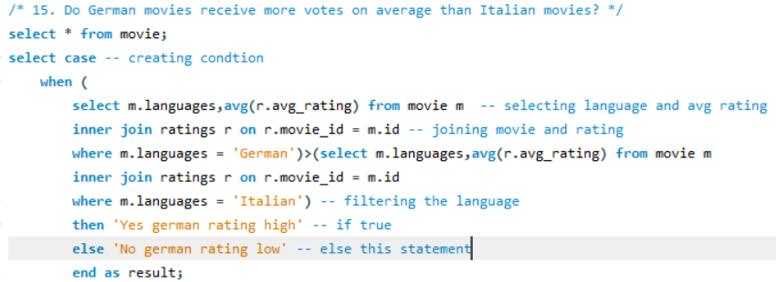

German vs Italian movie votes and movie with more than 8 average rating

Slide 8
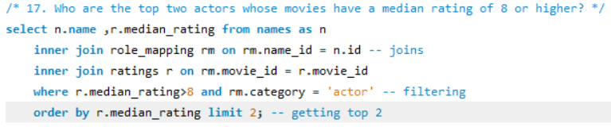

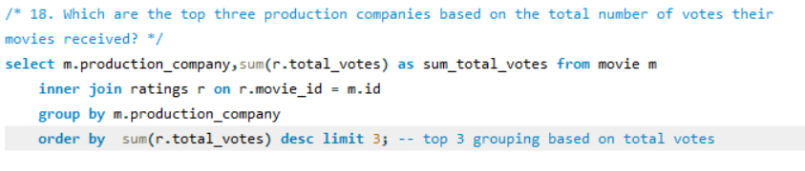
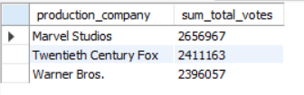
Top two actors based on median rating and top production company

Slide 9
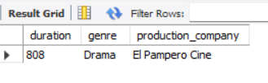
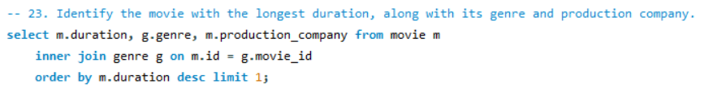
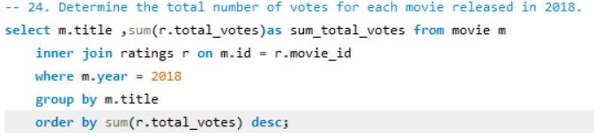
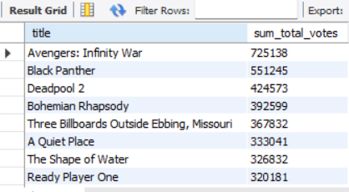
Longest duration movie and total movies by votes in 2018

Slide 10
Insights and conclusion
Declining Movie Releases (2017–2019): 3,252 in 2017 to 2,941 in 2018, and further to 2,098 in 2019
Seasonal Patterns: Peaks in January, September, and October suggest alignment with award seasons (e.g., Oscars) and holiday releases, while less in June, July, and late 2019
Genre Dominance: Drama is the most produced and top-voted genre, reflecting strong audience and creative preference, Horror being least duration and action being longest duration.
Production Company Disparity: Marvel Studios being highest and each films being lowest votes
Language Prevalence: English (possibly hollywood centric dataset)
Rating Trends: Median ratings 7–9 show high average ratings and votes, indicating mainstream appeal, while median 10 (10.0) with fewer votes suggests niche, critically acclaimed films.

